Slide 2
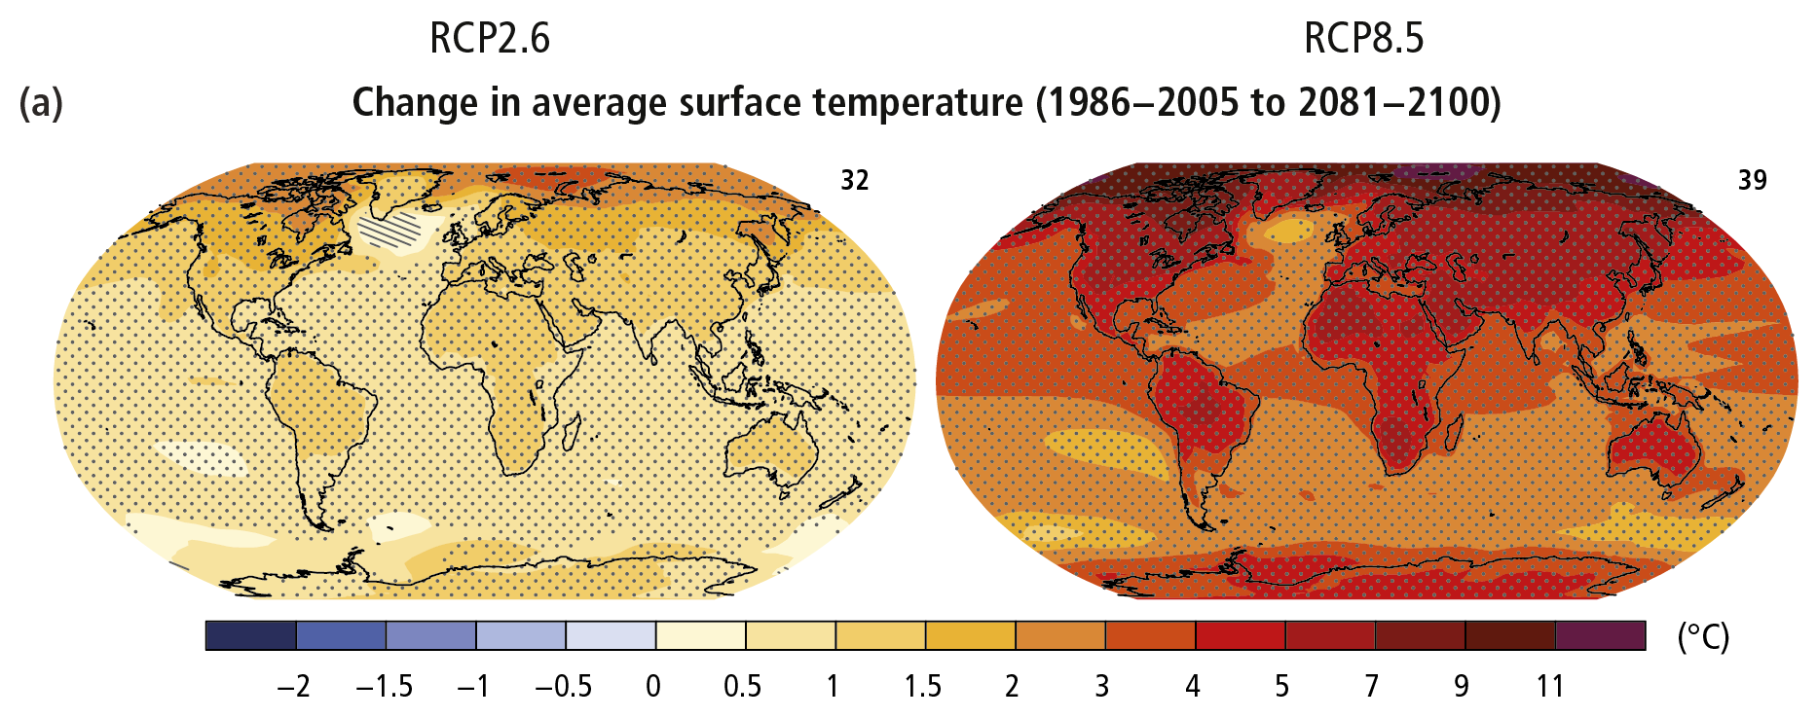
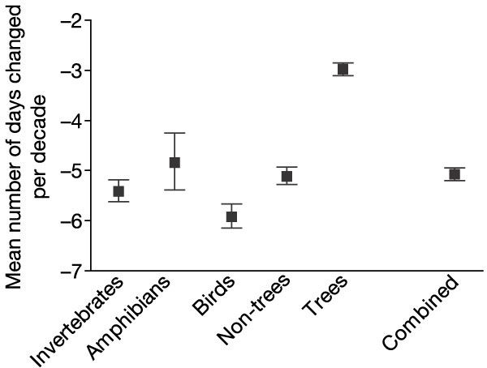
Climate Change and Phenology

Slide 3
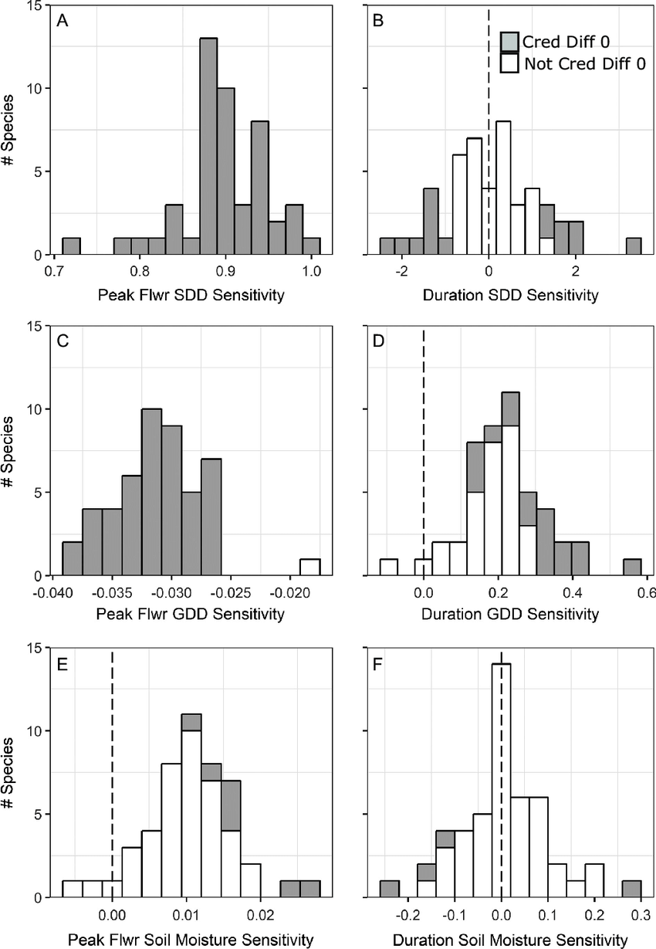
Phenological sensitivity
The shift in phenological event date per degree of temperature change

Slide 4
How does differential phenological sensitivity mediate plant interactions?

Slide 5
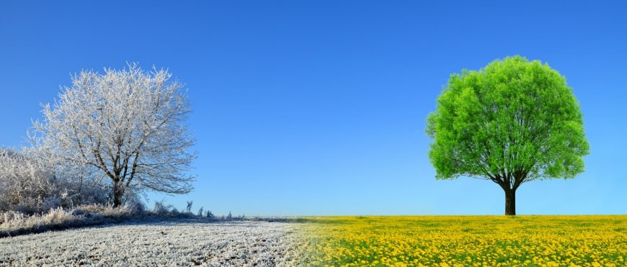
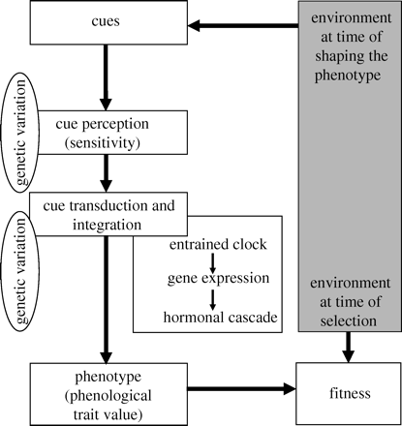
Phenological transition: dormancy to growth
Insert picture of bud and seed here
Openworksweb.com
Visser 2010

Slide 6
Research Overview

Slide 7
Background and Question

Slide 8
Hypotheses:

Slide 9
Methods

Slide 10
Preliminary results

Slide 11
Background and Question

Slide 12
Hypotheses:

Slide 13
Methods

Slide 14
Current status

Slide 15
Background and questions
Figure with 1 stratification level
Steadman figure
Notes:
Germination is a critical fitness step. Very temperature sensative

Slide 16
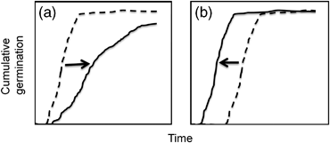
Background and questions
Walck 2011
Notes:
Shifts of germination phenology between now (dashed lines) and the future (solid lines) with global warming for species requiring cold stratification. (a) Seedling emergence will be delayed if the current length of cold stratification approximates the minimum requirement. In this case, shortened winters will not adequately overcome dormancy and seeds will require increased time in spring to germinate. (b) Emergence will be earlier if the current length of stratification greatly exceeds the minimum required. Seeds remain un‐germinated (but nondormant) until spring temperatures warm, and thus shortened winters do not affect dormancy break but premature spring warm‐up accelerates germination.

Slide 17
Background and Questions
Write questions here
With hypotheses

Slide 18
Methods
Show pictures of chambers here

Slide 19
Methods
Thermal time model
Calculation of Tb
Evaluation of sensativity of Tb
Phenological reassembly?

Slide 20
Project status
Show figure

Slide 21
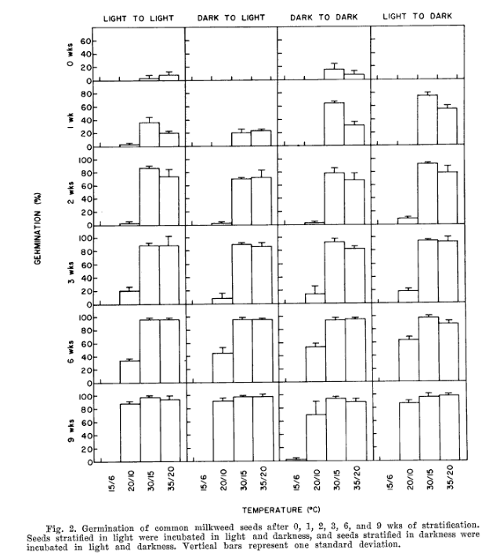
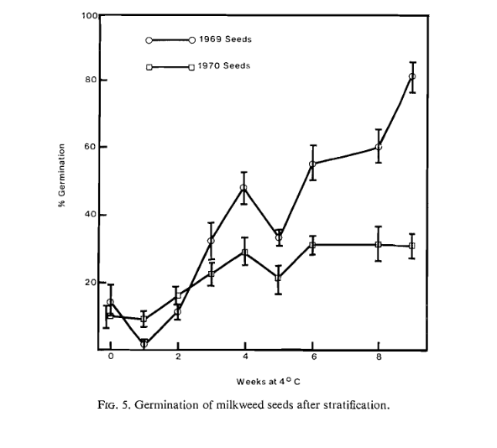
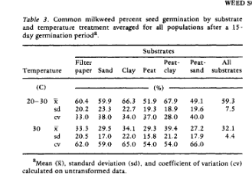
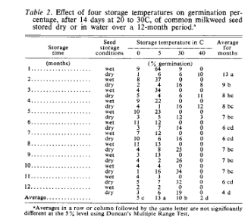
Background: OEGREs
Notes:
Evetts 1972
Oegema and Fletcher 1972
Farmer 1986
Baskin and Baskin 1977
Add picture of Ascleptias only

Slide 22
Questions:
Notes:
Map of eastern US to global map with points all over the world

Slide 23
Methods

Slide 24
Project Status

Slide 25
Seasonal Priority Effects

